Slide 1
DARK WEB CRAWLER AND SCRAPER WITH LLM-BASED SECURITY ANALYSIS
TEAM MEMBERS: 1. ROJA S (620822205089)
2. SWETHA S (620822205112)
3. SARANYA M (620822205095)
4. SHARMILA K (620822205099)
GUIDE : Mrs.S.SARANYA,AP/IT
GNANAMANI COLLEGE OF TECHNOLOGY.

Slide 2
Problem Statement
Exploring the dark web manually is time-consuming and risky.
Hidden links and anonymous sites make navigation difficult.
Traditional web crawlers cannot access Tor-based dark web sites.
Extracting relevant information manually is inefficient and prone to errors.
Security and privacy concerns make dark web data collection challenging
There is a lack of systematic analysis of existing crawler and scraper architectures

Slide 3
Objective
To design a dark web crawler capable of navigating Tor network safely.
To implement a scraper module that efficiently extracts relevant data.
To analyze and filter the collected data for meaningful insights.
To evaluate existing crawler and scraper architectures for performance
To address challenges like anonymity, security, and ethical issues
To provide a systematic overview for future dark web research

Slide 4
Existing System
Current web crawlers are mainly designed to explore the surface web and cannot access dark web content that runs on the Tor network. Manual exploration of the dark web is risky, time-consuming, and unsafe. Most existing scrapers are not built to handle anonymous or hidden websites, making data extraction difficult. Collecting information from the dark web also requires stronger security measures, which many systems lack.
Disadvantage
Manual dark web exploration is slow, risky, and inefficient. ️
Normal crawlers cannot access Tor-based hidden websites.
Existing scrapers struggle with encrypted or dynamic content.
Ethical, legal, and large data handling issues reduce effectiveness.

Slide 5
Proposed System :
The proposed system develops a secure dark web crawler that can safely navigate the Tor network. It includes an automated scraper module to efficiently extract relevant information from dark web pages. A data analysis layer is added to filter, organize, and process the collected data, while encrypted storage ensures that all information is stored securely. The system also incorporates ethical and legal controls to promote responsible crawling.
Advantage :
Automated crawling saves time and improves speed and accuracy.
Can safely access Tor-based dark web content.
Secure storage and organized data improve reliability.

Slide 6
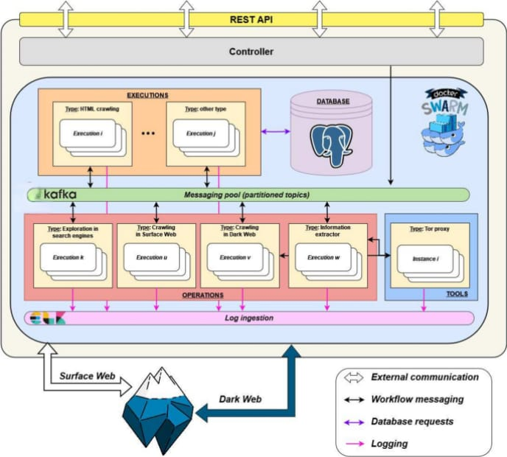
SYSTEM ARCHITECTURE/FLOW DIAGRAM

Slide 7
Modules :
Module 1 – Crawler Module
Navigates dark web links safely using the Tor network.
Module 2 – Scraper Module
Extracts relevant and structured data from crawled pages.
Module 3 – Data Analysis Module
Filters, processes, and analyzes collected information using AI techniques.
Module 4 – Storage & Security Module
Stores data securely in encrypted databases with controlled access.
Module 5 – Reporting & Monitoring Module
Generates intelligence reports and monitors system performance.

Slide 8
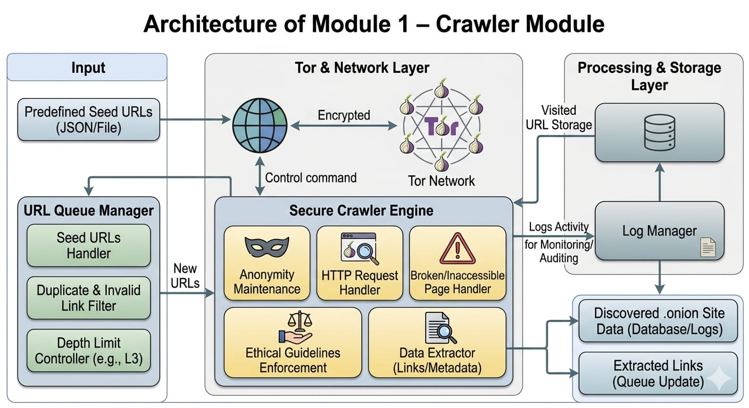
Module 1 – Crawler Module
WORKING:
Automatically discovers dark web (.onion) websites using predefined seed URLs.
Establishes secure and anonymous connections through the Tor network.
Crawls linked pages automatically within a defined depth limit.
Avoids duplicate, invalid, broken, or inaccessible links efficiently.
Stores visited URLs to prevent repetition and improve crawling performance.
Maintains ethical crawling practices and logs activities for monitoring and auditing.

Slide 9
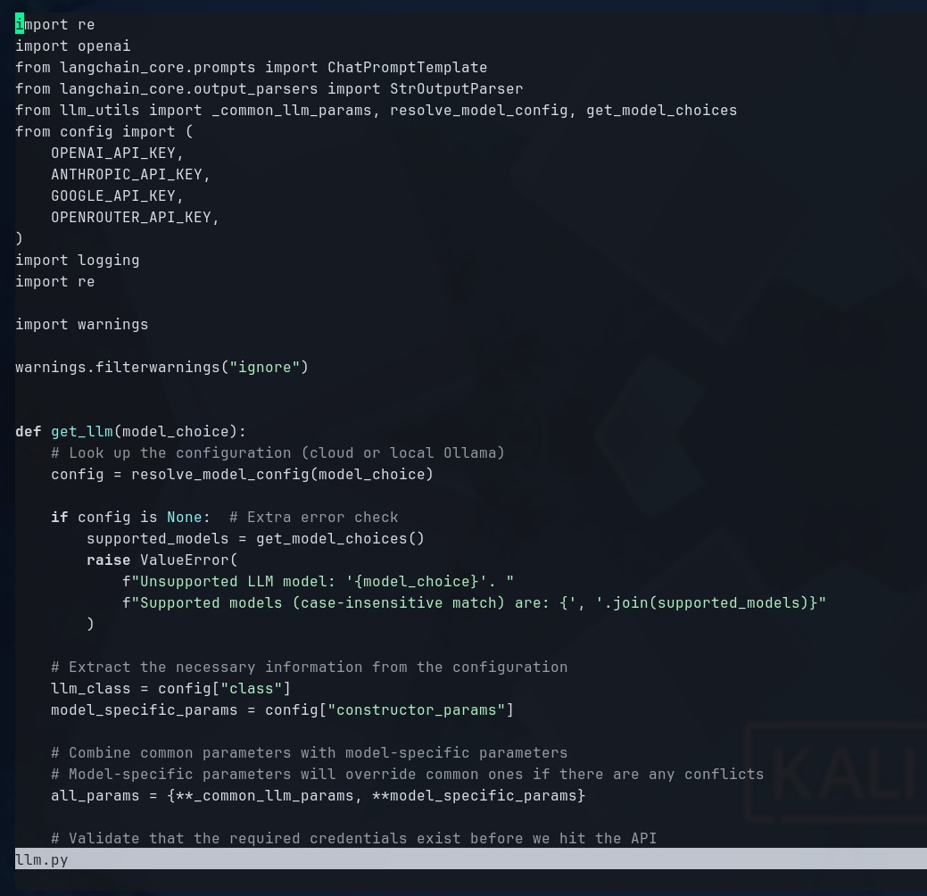
Coding Part 1

Slide 10
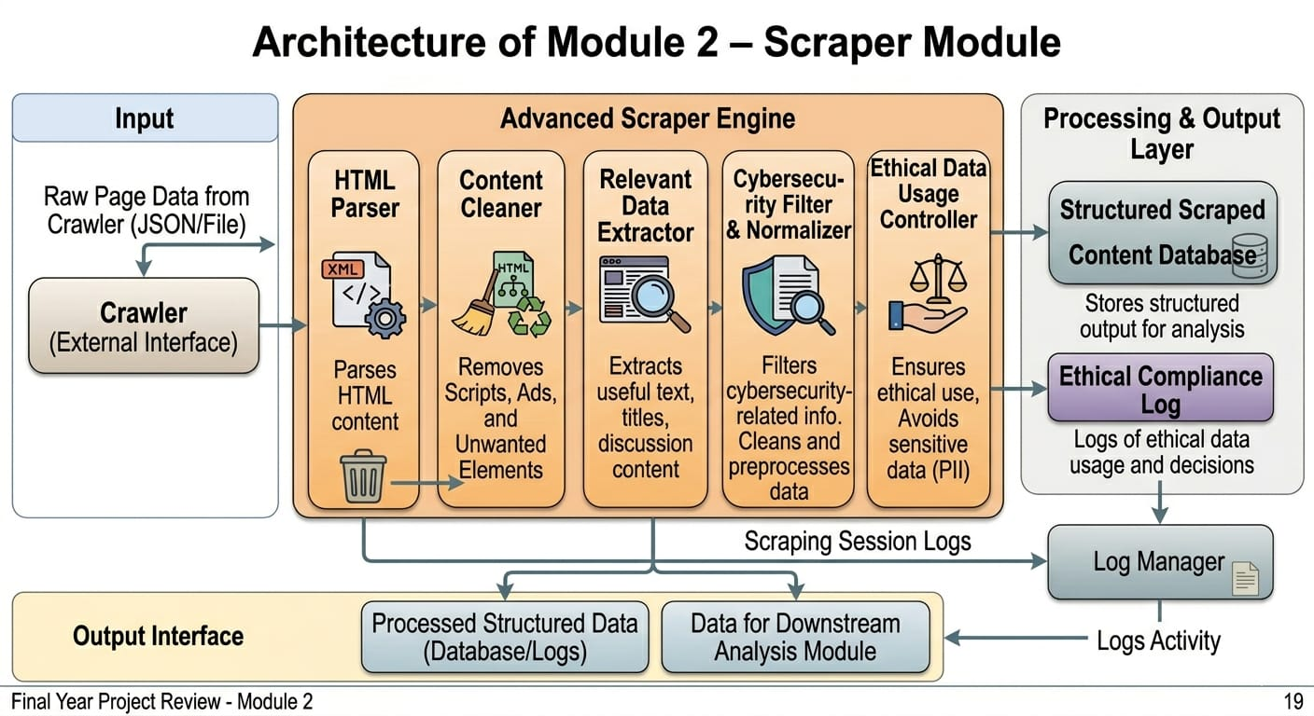
Module 2 – Scraper Module
WORKING:
Receives raw page data from the crawler and parses HTML content from collected pages.
Removes scripts, ads, and unwanted elements to clean the extracted data.
Extracts useful text, titles, and discussion content from web pages.
Cleans, preprocesses, and converts raw data into a structured format.
Filters only cybersecurity-related information and stores the output for further analysis.
Maintains logs while ensuring ethical, responsible, and privacy-conscious data usage.

Slide 11
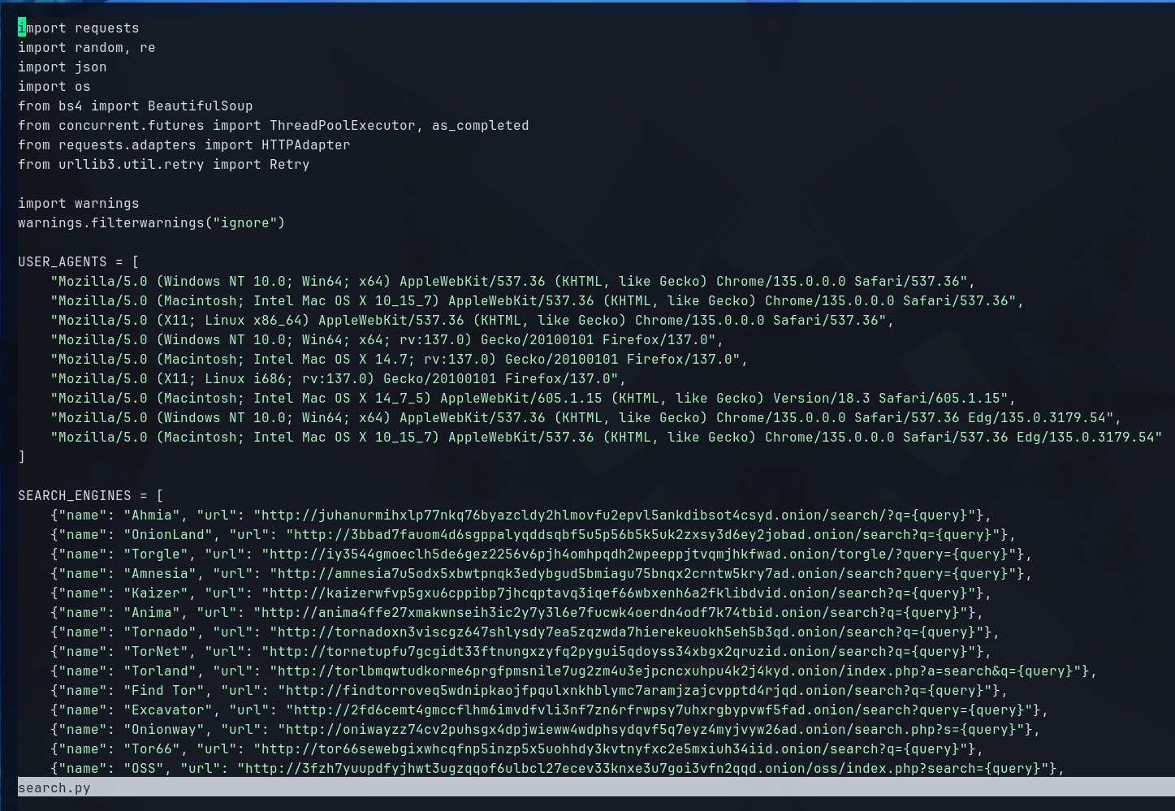
Coding Part 2

Slide 12
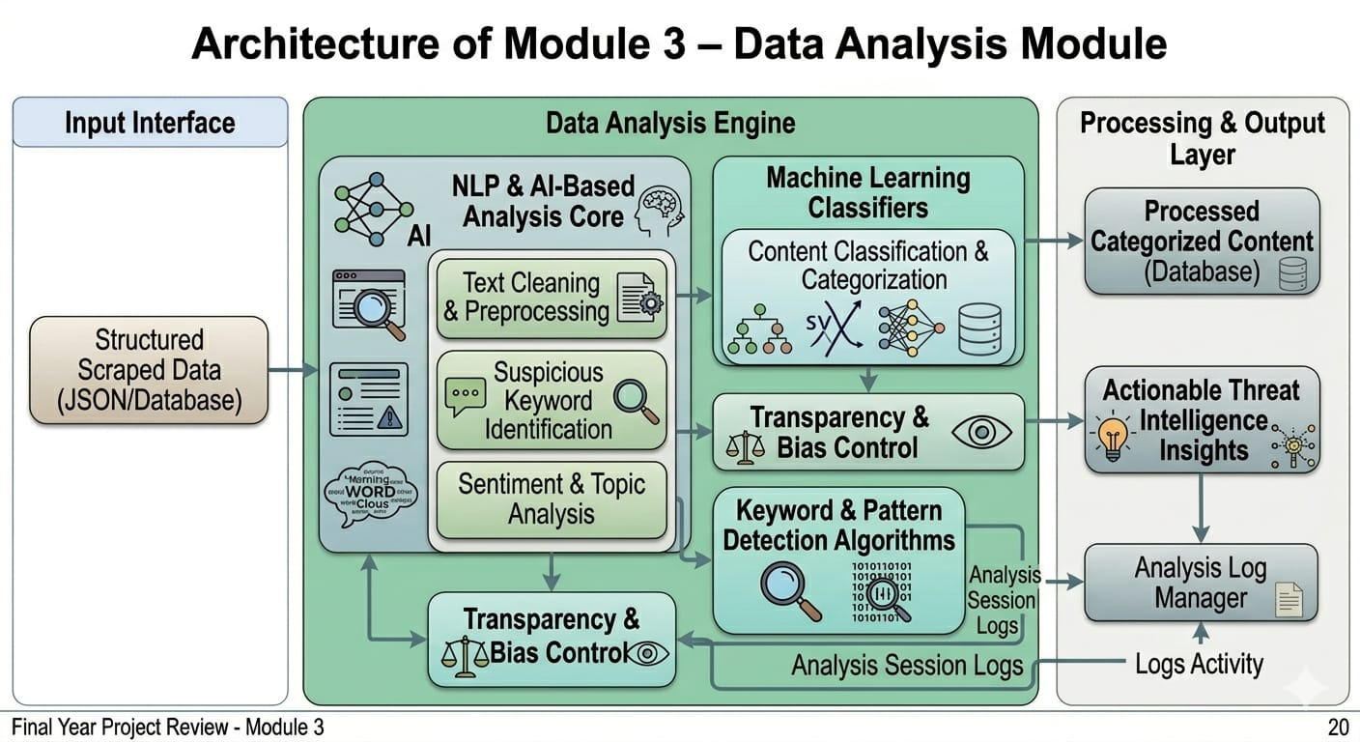
Module 3 – Data Analysis Module
WORKING:
Processes structured data from the scraper to detect threats, risks, and hidden patterns.
Performs text cleaning, preprocessing, and suspicious keyword identification.
Applies NLP and AI-based techniques for advanced data analysis.
Classifies content into meaningful categories using pattern detection algorithms.
Performs sentiment, topic analysis, and generates actionable threat intelligence insights.
Maintains transparency, reduces AI bias, and follows cybersecurity research standards.

Slide 13
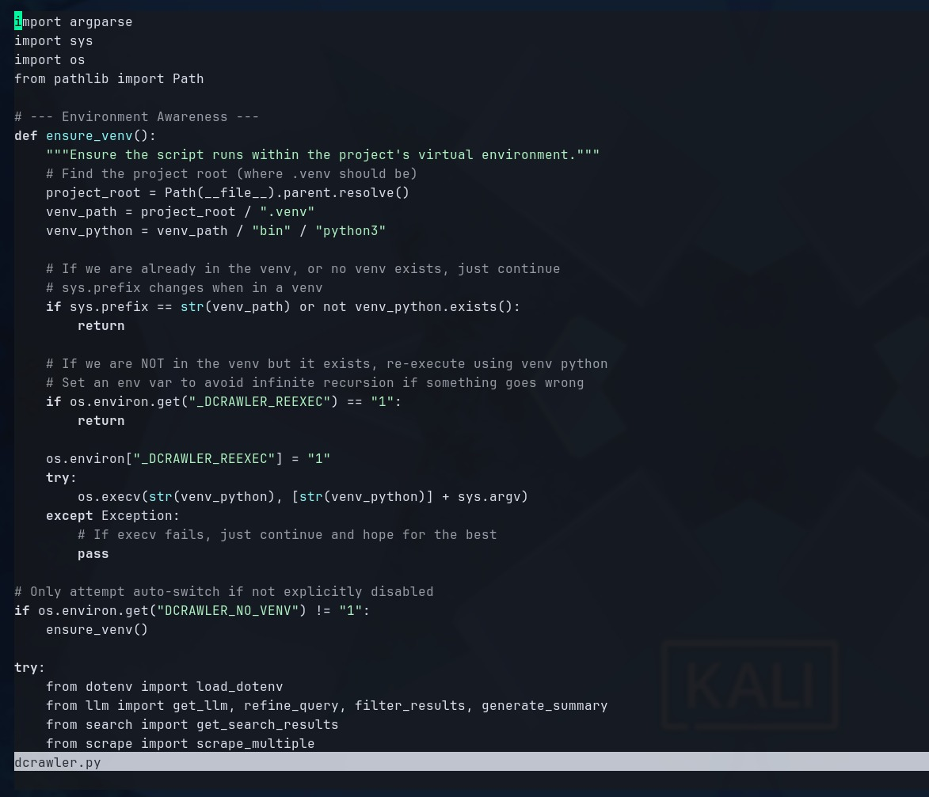
Coding Part 3

Slide 14
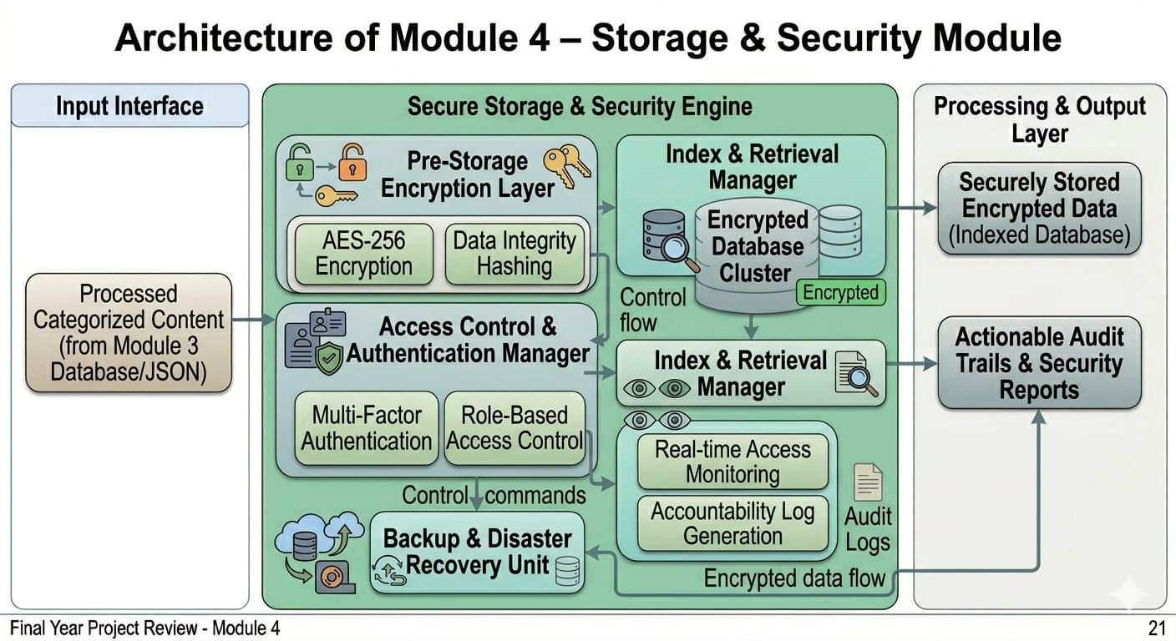
Module 4 – Storage & Security Module
WORKING:
Receives processed data and securely stores collected and analyzed information.
Encrypts sensitive data before storing it in secure databases.
Implements strong authentication and access control mechanisms.
Indexes stored data for quick retrieval and efficient manage.
Protects data integrity, prevents unauthorized access, and follows security standards.

Slide 15
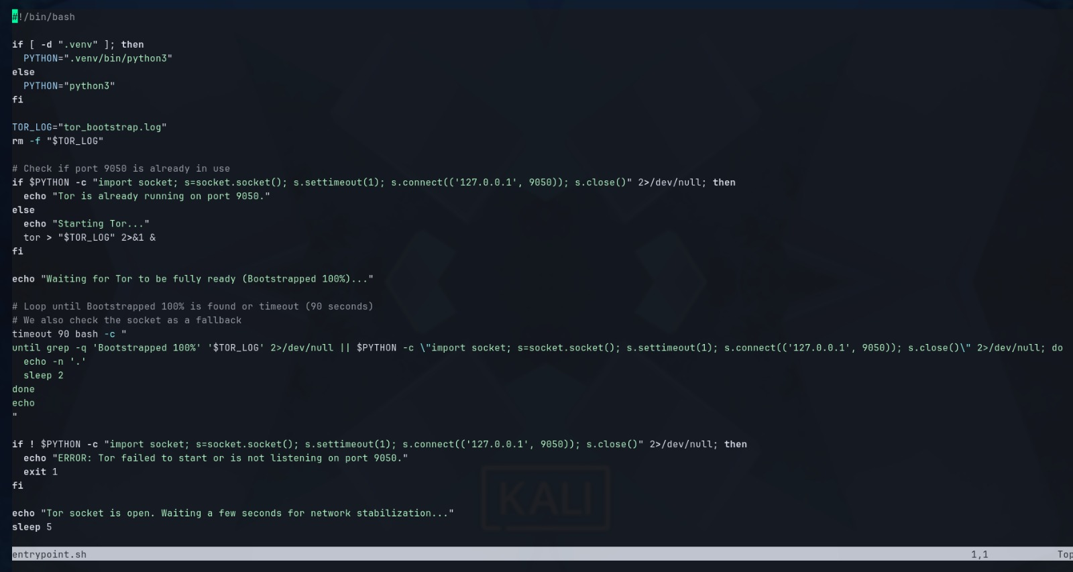
Coding Part 3

Slide 16
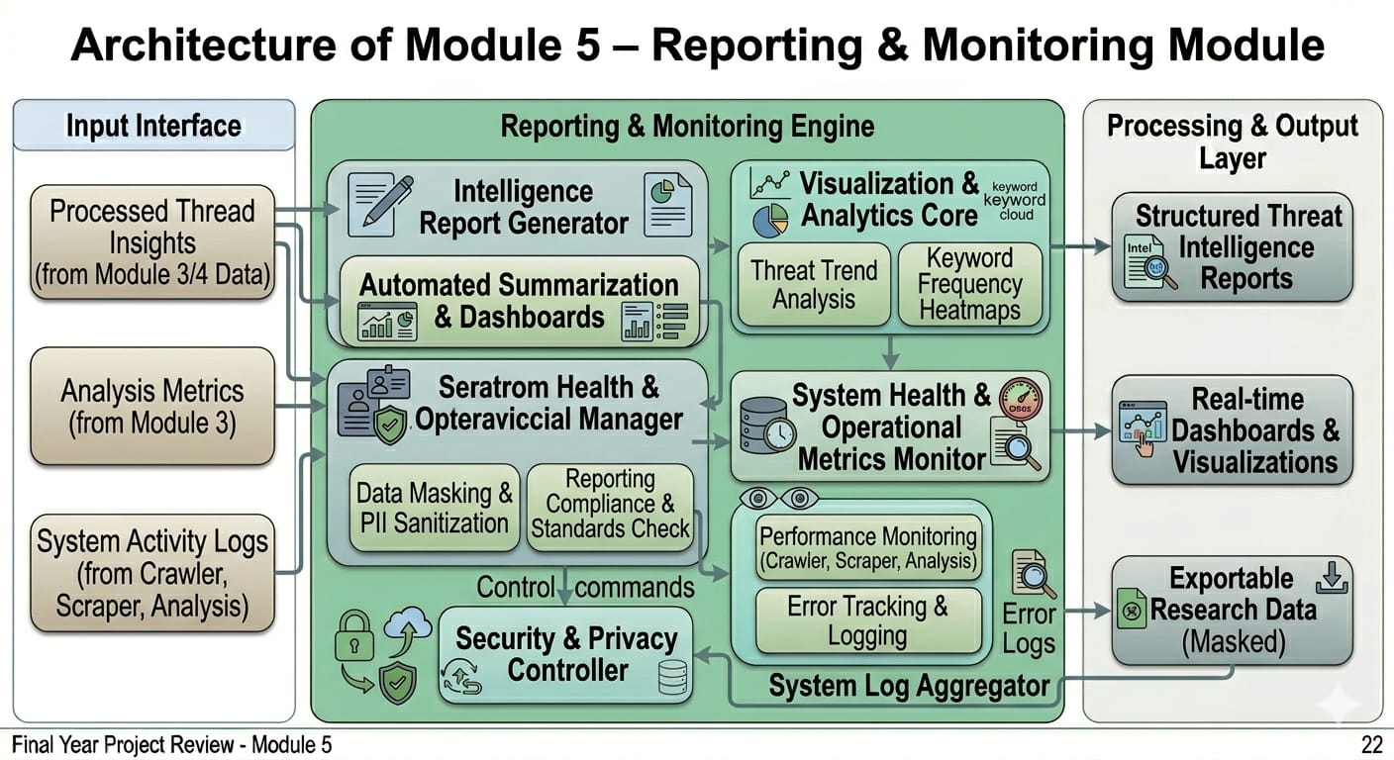
Module 5 – Reporting & Monitoring Module
WORKING:
Generates intelligence reports and structured summaries of detected threats.
Provides dashboards and visualizations for trends and keyword frequency.
Monitors crawler, scraper, and analysis performance with system health tracking.
Tracks system errors, operational metrics, and maintains activity logs.
Restricts report access, masks sensitive data, and follows security compliance standards.

Slide 17
Conclusion
Dark web crawler and scraper system enables safe and efficient exploration of hidden web content.
Tor network integration ensures anonymity and security for researchers.
Modular design allows easy upgrades and maintenance.
Data analysis and filtering provide structured and meaningful insights.
Secure storage ensures data integrity and protection.
Ethical and legal controls minimize risks of misuse.
THANK YOU !

